Slide 1


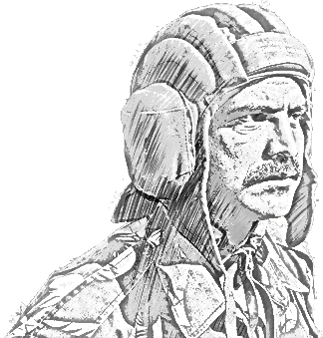
SCHOOL OF TECH TRG
ALWAYS CONNECTED
ELECTRONICS WING

Slide 2
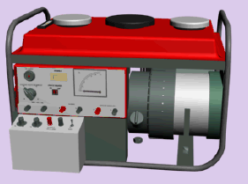
CHARGING ENG HONDA
GEN & CONTROLS

Slide 3
SCOPE
BHAG NO-I GENERAL
BHAG NO-II CONTROLS

Slide 4
BHAG NO-I GENERAL

Slide 5
AMBAYAN
CHARGING ENGINE HONDA E 1000K DC MODEL GK 100, 4 STROKE SIDE VALVE SINGLE CYLINDER CHARGING SET. 6V, 12V AND 24V BTYS CAN BE CHARGED WITH IT. THE MAXIMUM CHARGING OUT PUT IS 16.5 AMP..

Slide 6
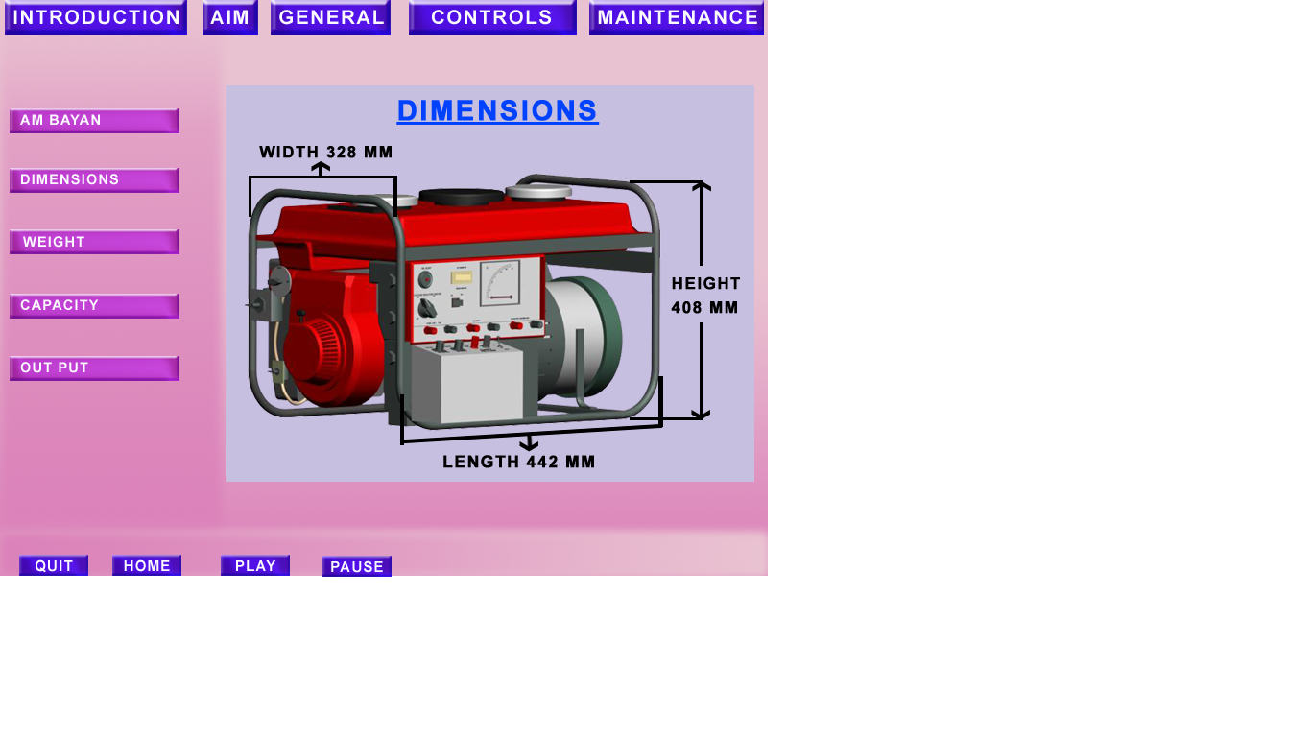
DIMENSION
1. LENGTH - 442MM
2. WIDTH - 328MM
3. HEIGHT - 408MM

Slide 7
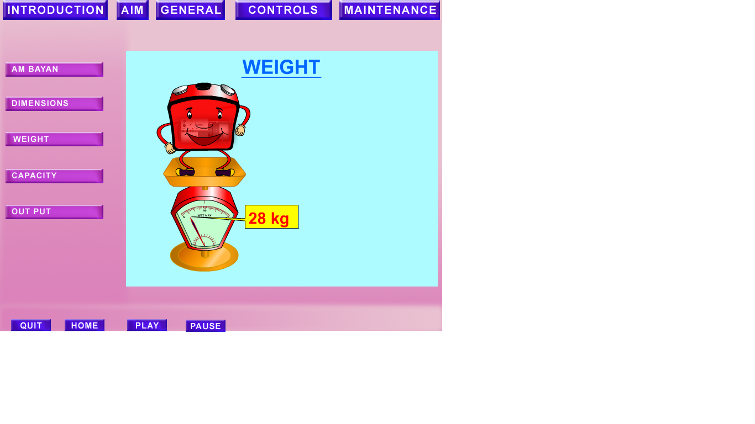
WEIGHT
WEIGHT -28 KG

Slide 8
CAPACITY
COOLING SYSTEM - AIR COOLED
IGNITION SYSTEM - TRANSISTORISED IGNITION
OIL CAPACITY - 0.43 LTR(20W40)
FUEL CAPACITY - 6.5 LTR (KEROSENE)
PETROL - 0.4 LTR
OPERATING SPEED - 2500 – 3600 RPM

Slide 9
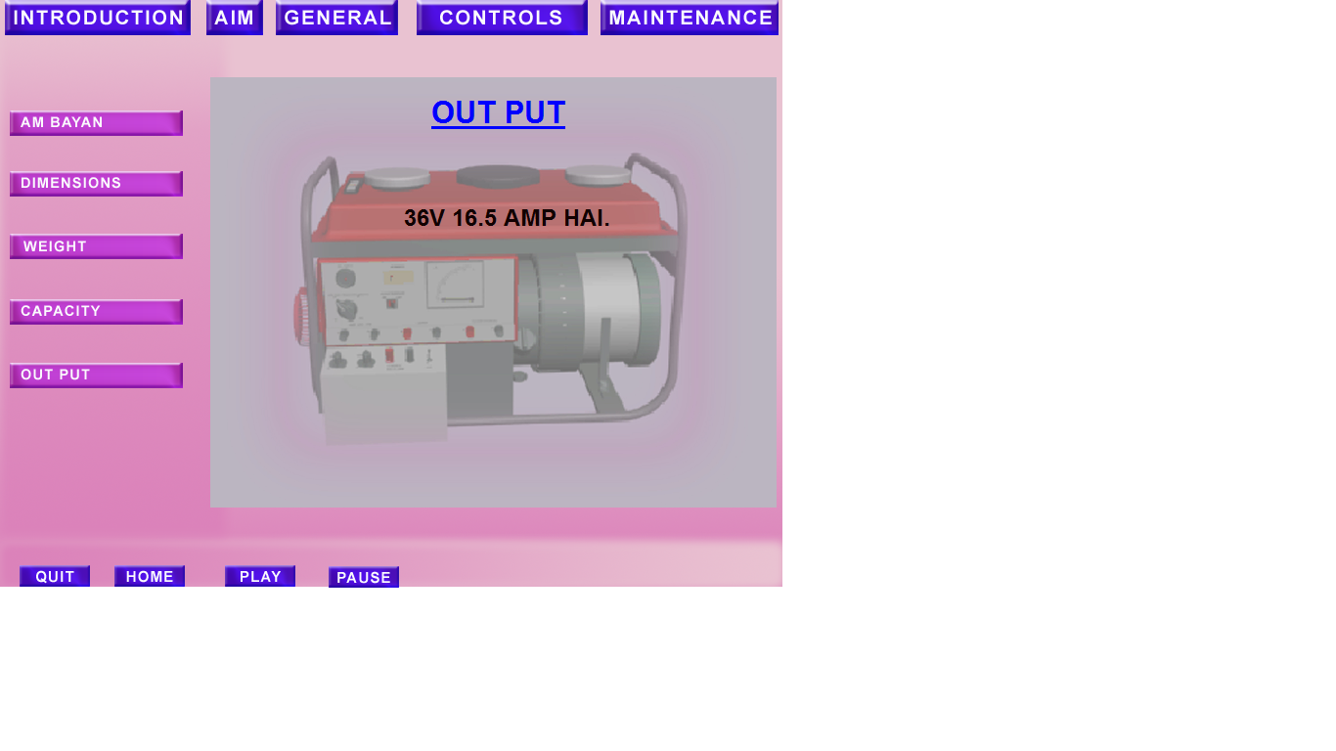
OUT PUT
OUT PUT - 36V 16.5 AMP.

Slide 10
BHAG NO-II CONTROLS

Slide 11
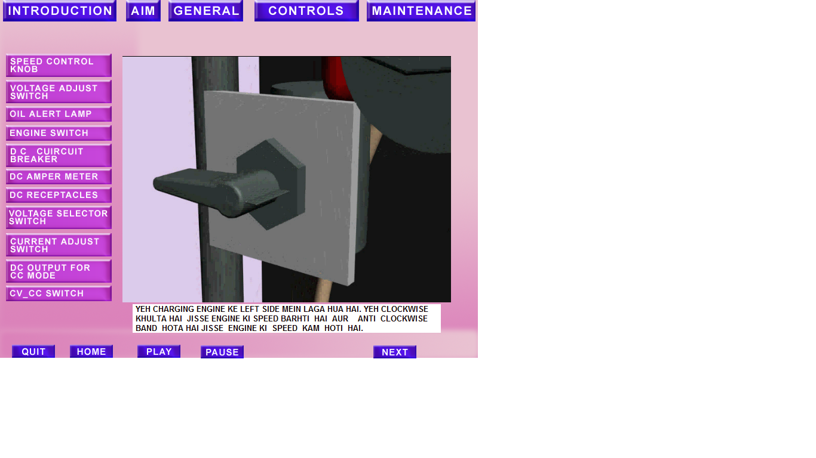
SPEED CONTROL KNOB

Slide 12
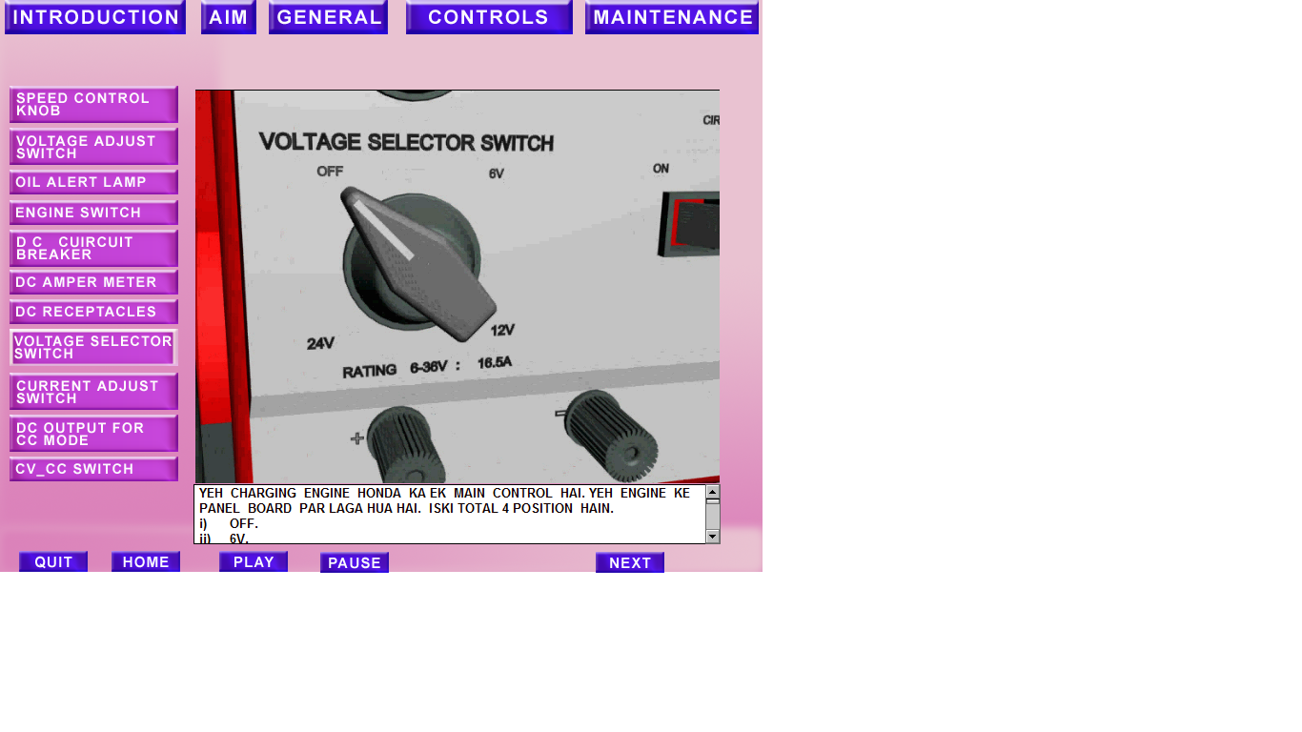
VOLTAGE SELECTOR SWITCH

Slide 13
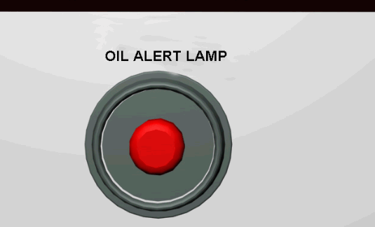
OIL ALERT LAMP

Slide 14
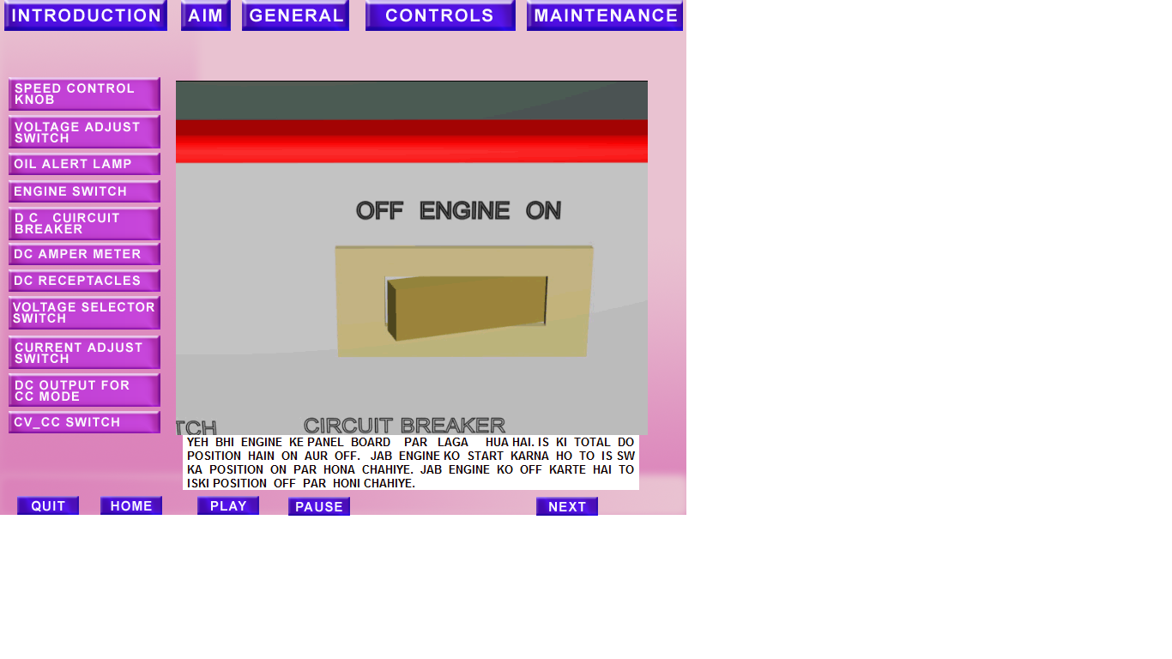
ENGINE SWITCH

Slide 15
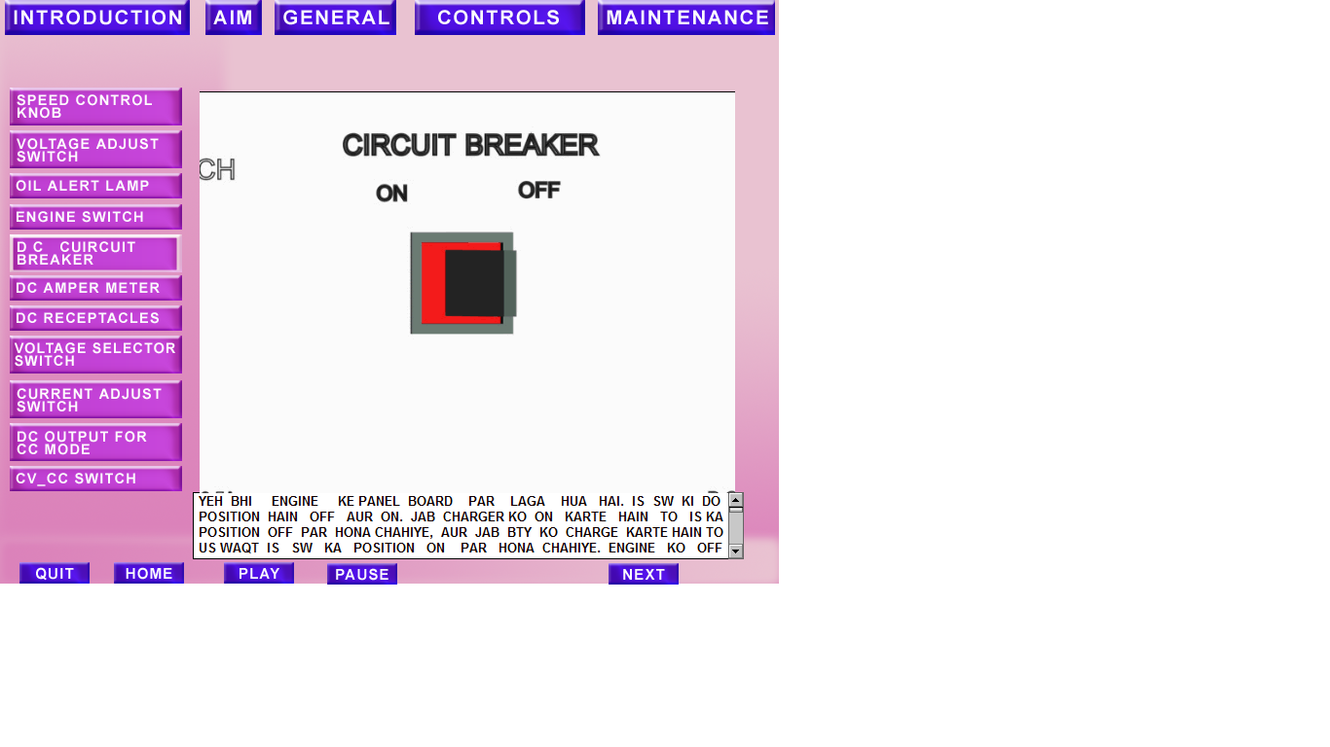
DC CIRCUIT BREAKER

Slide 16
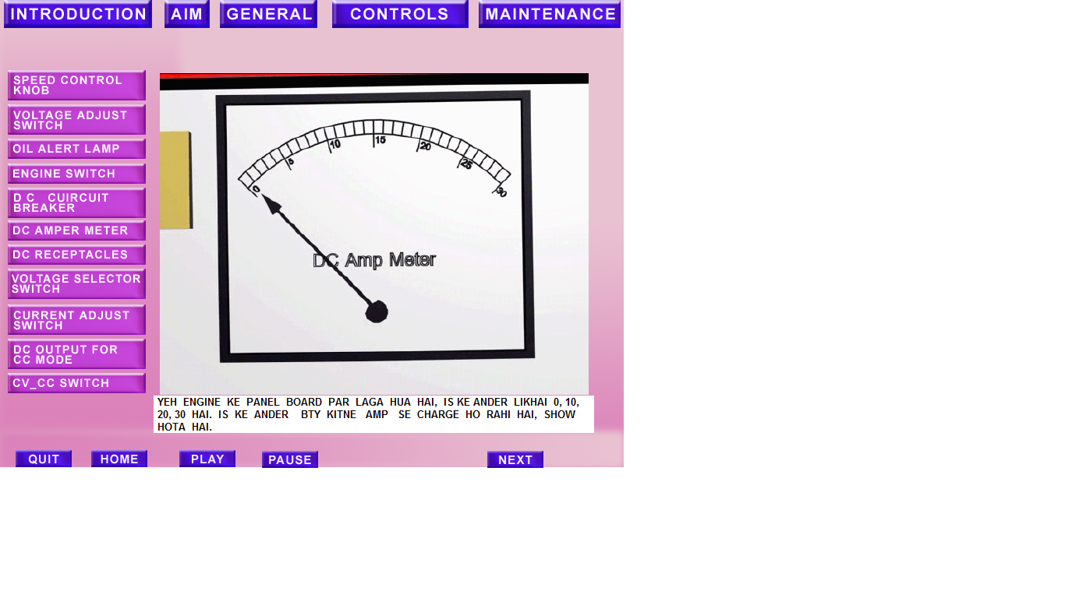
DC AMPER METER

Slide 17
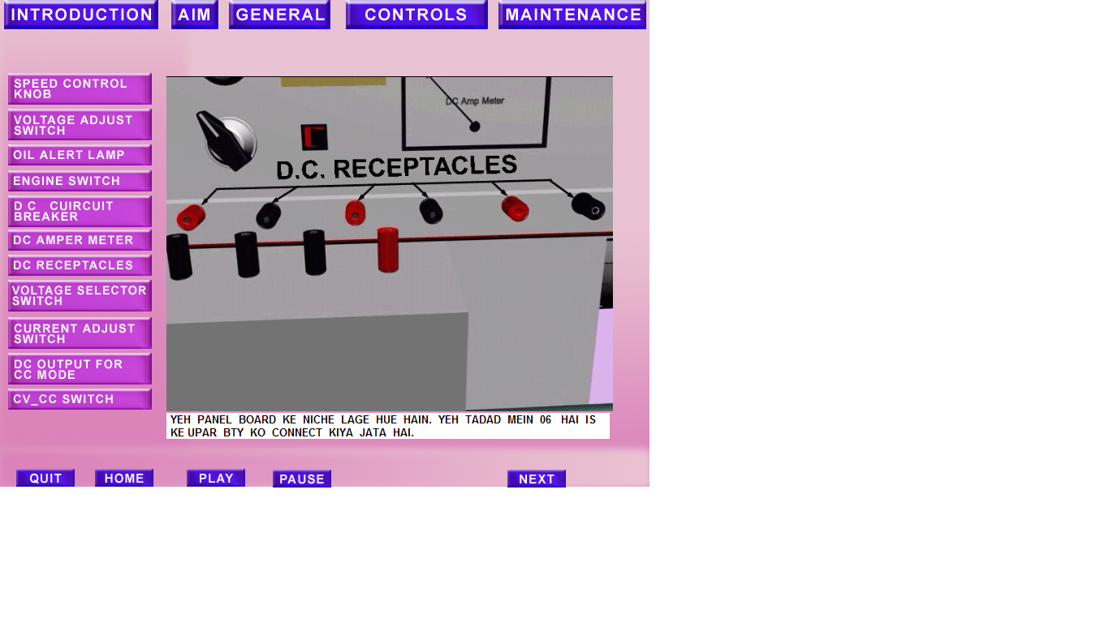
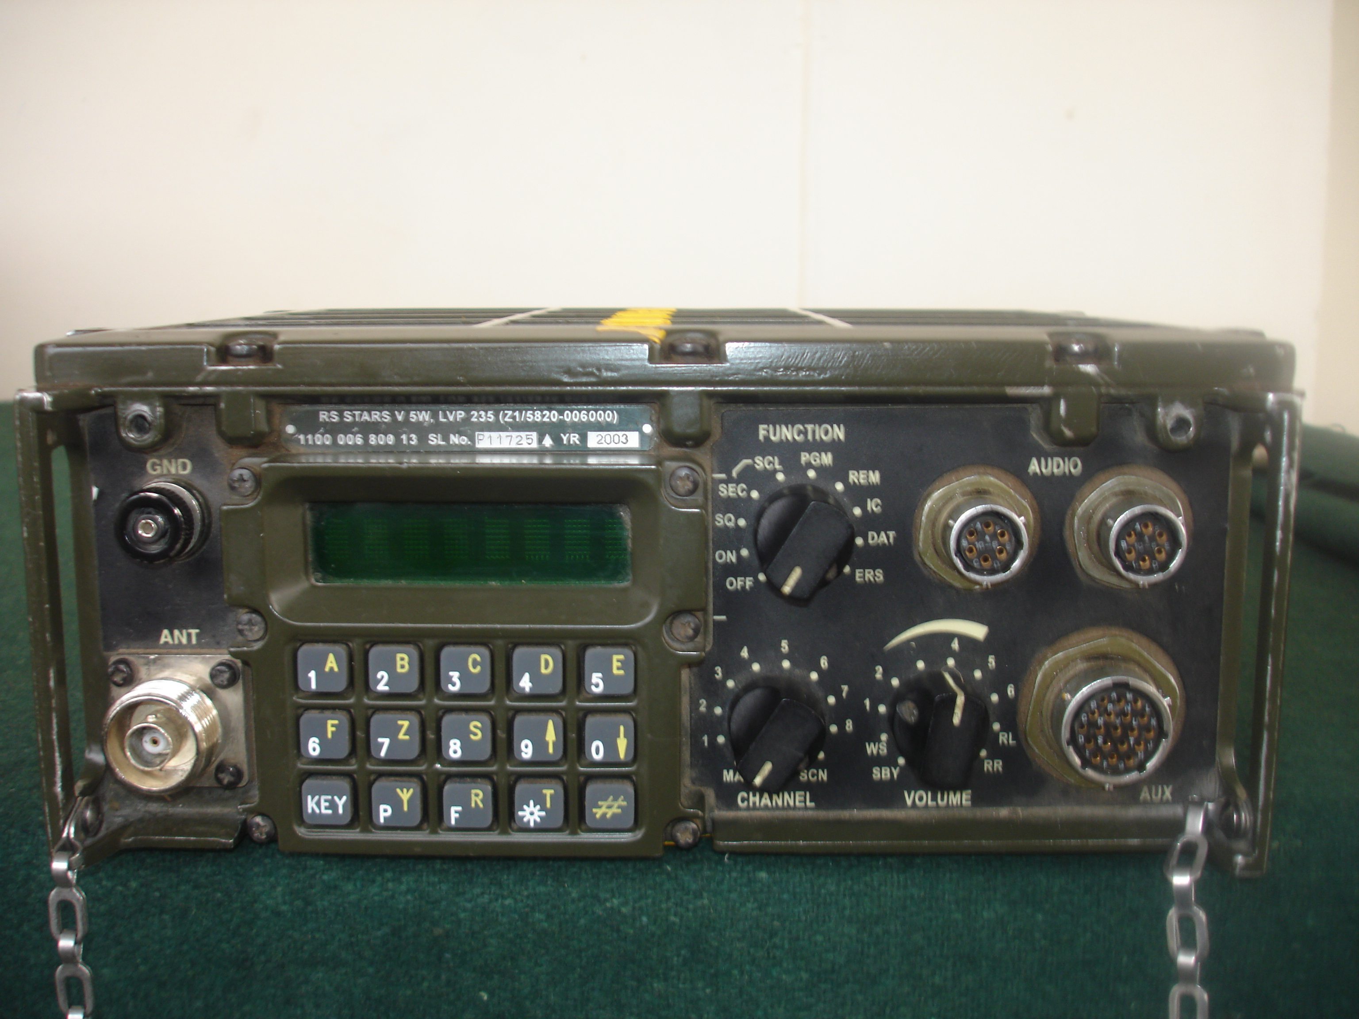
DC RECEPTACLES

Slide 18
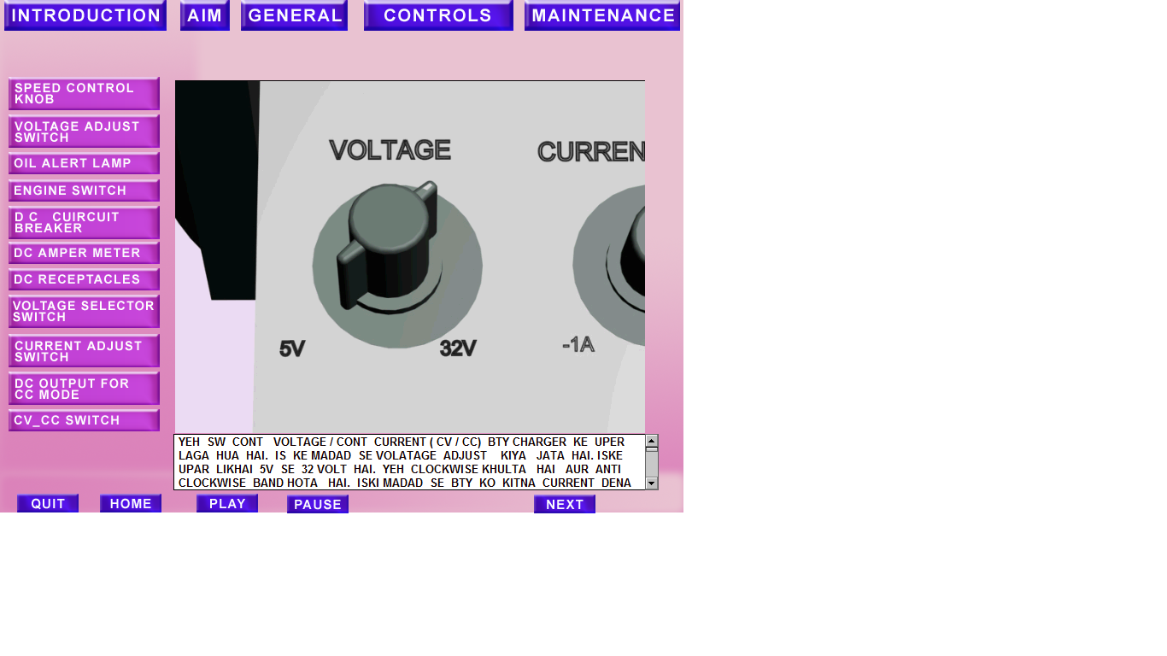
VOLTAGE ADJUST SWITCH

Slide 19
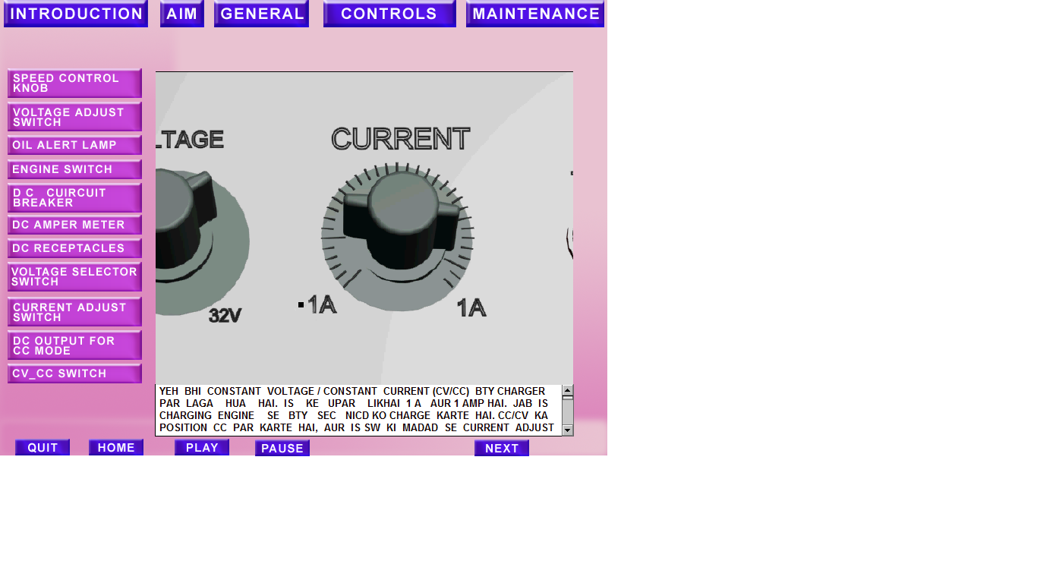
CURRENT ADJUST SWITCH

Slide 20
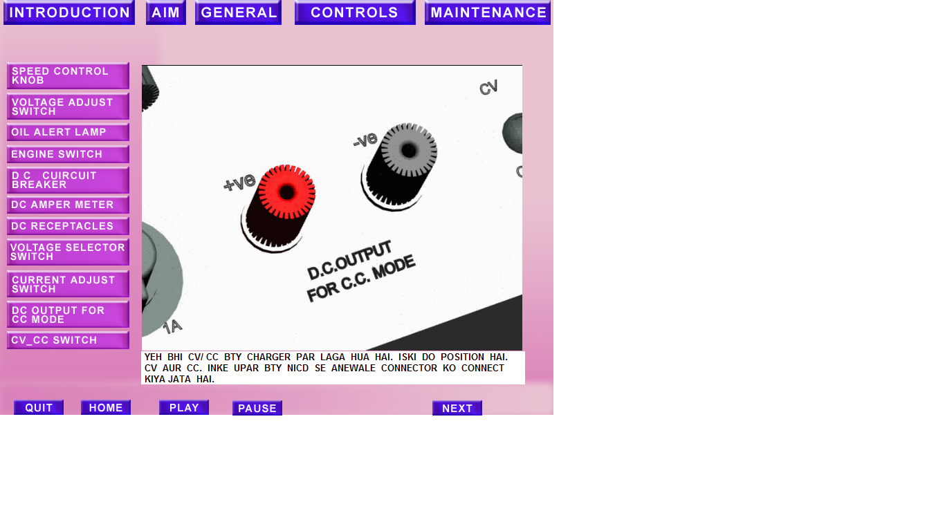
DC OUTPUT FOR C.C. MODE

Slide 21
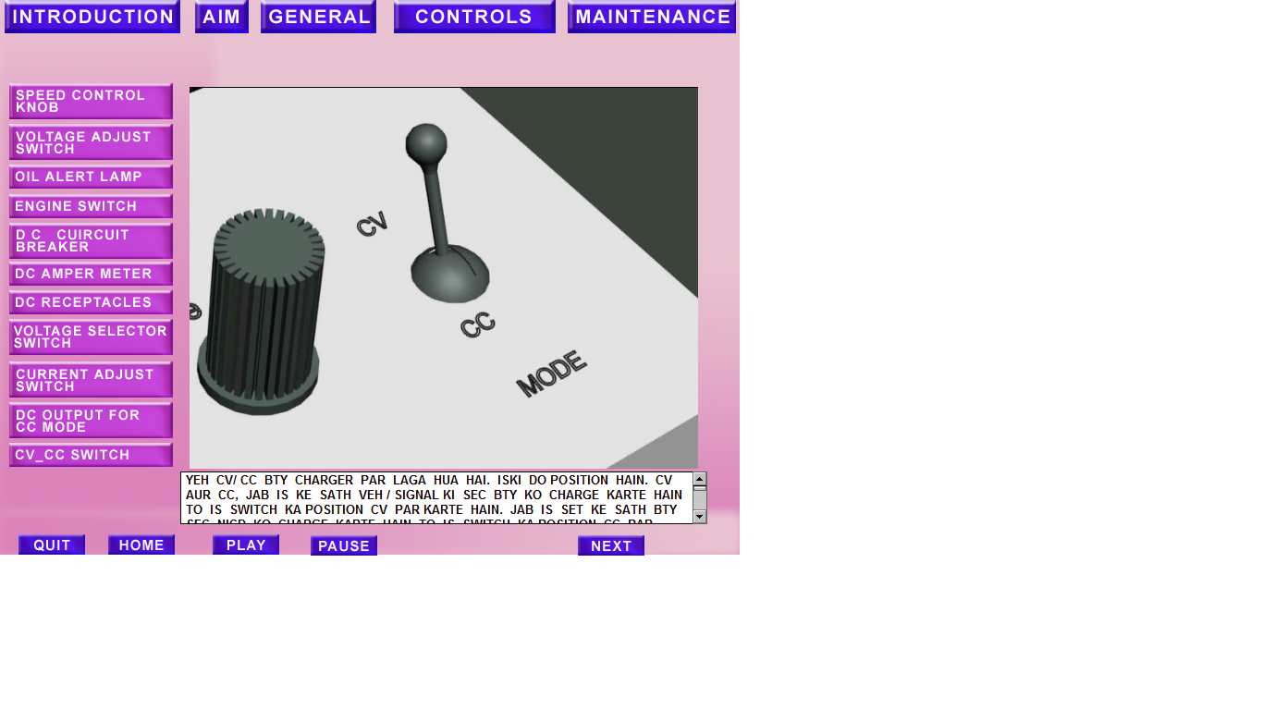
CV/CC SWITCH

Slide 22
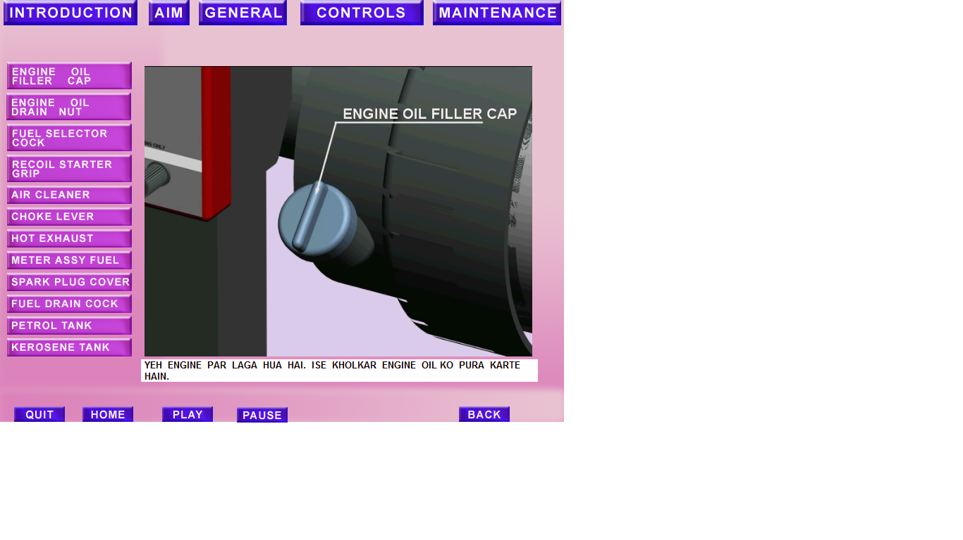
ENGINE OIL FILLER CAP

Slide 23
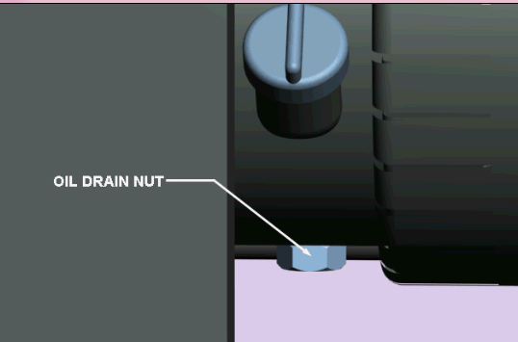
OIL DRAIN NUT

Slide 24
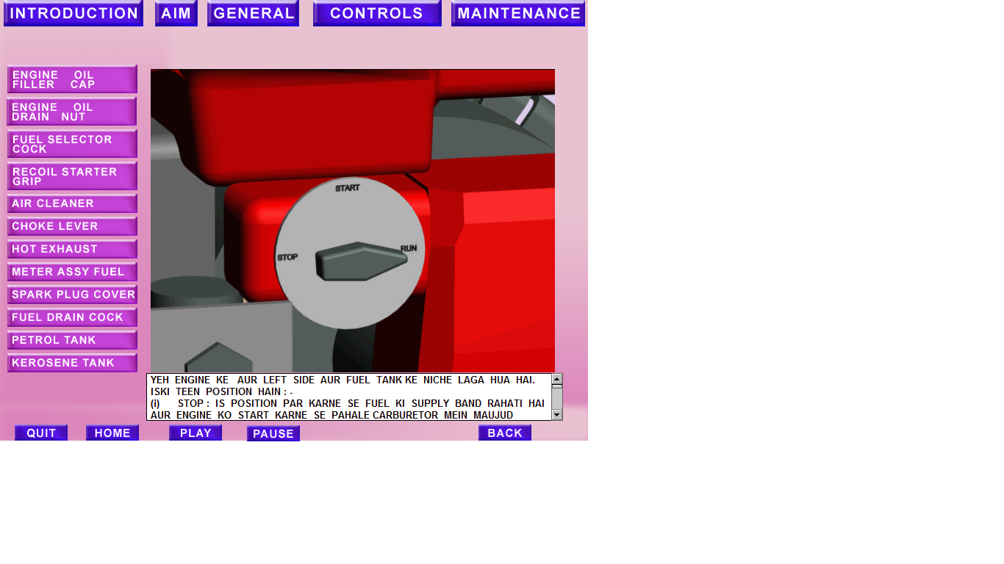
FUEL COCK

Slide 25
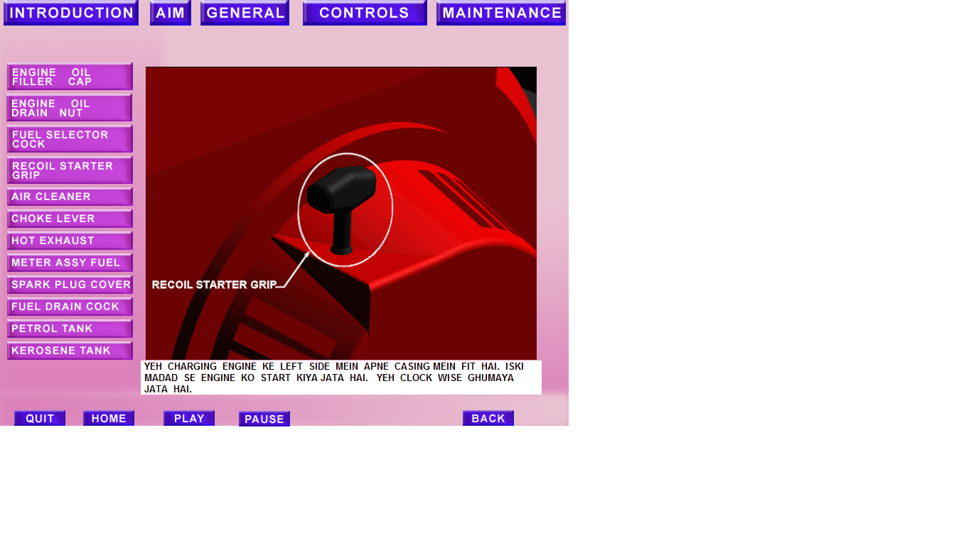
RECOIL STARTER GRIP

Slide 26
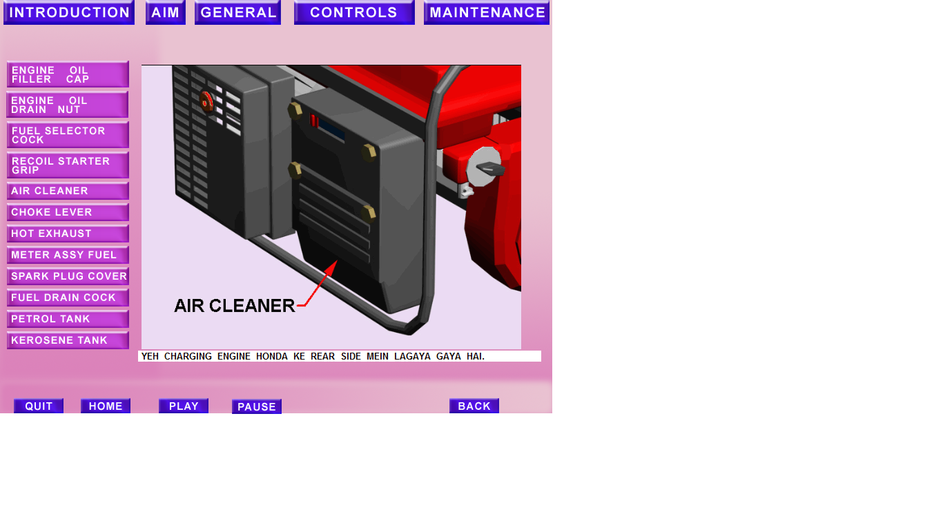
AIR CLEANER

Slide 27
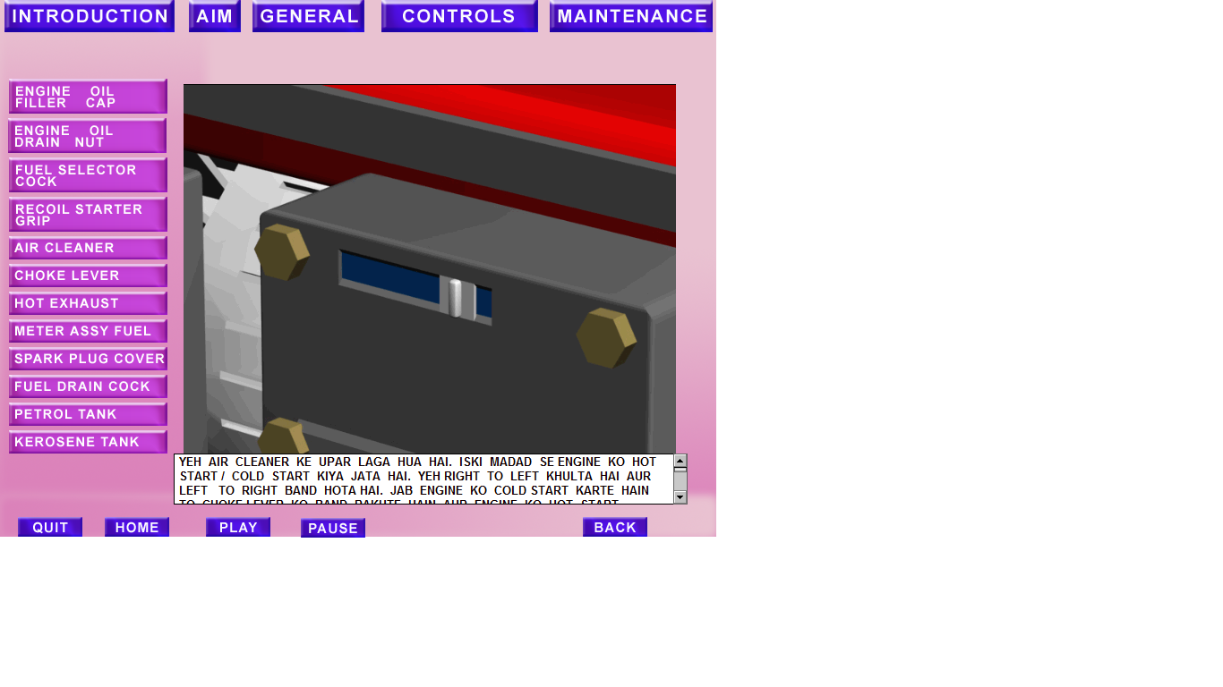
CHOKE LEVER

Slide 28
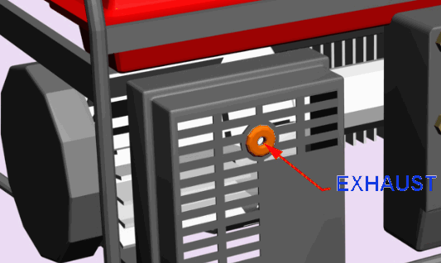
HOT EXHAUST

Slide 29
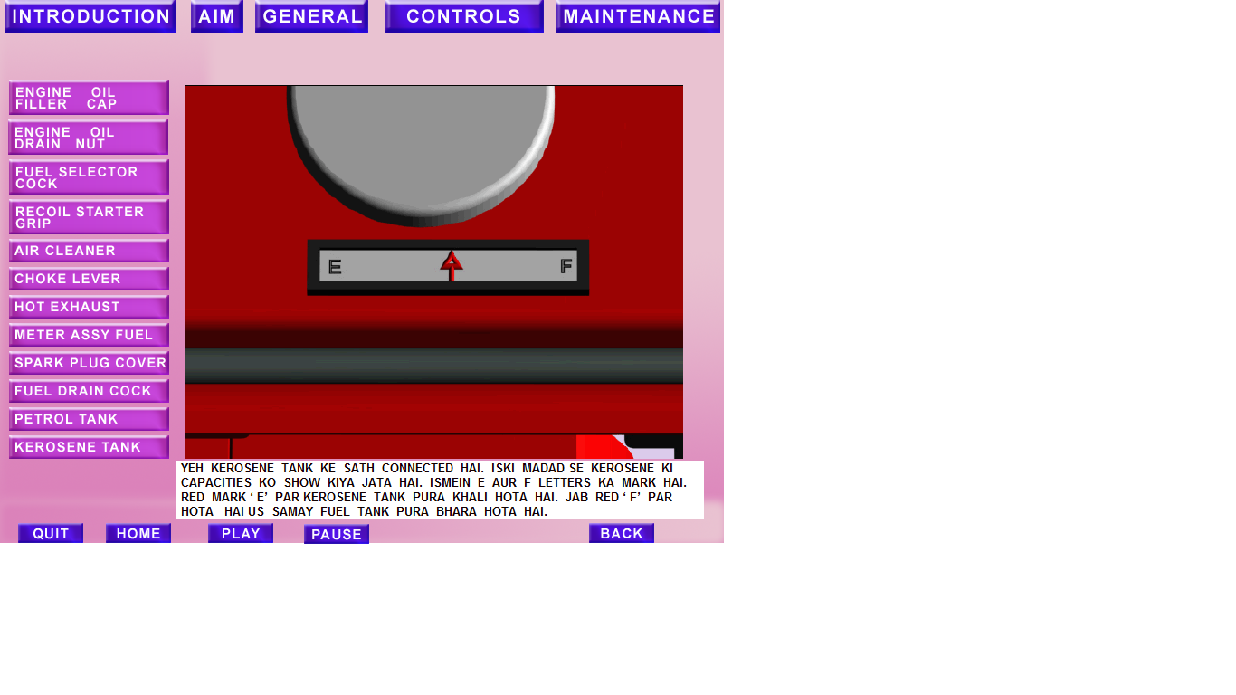
METER ASSY FUEL

Slide 30
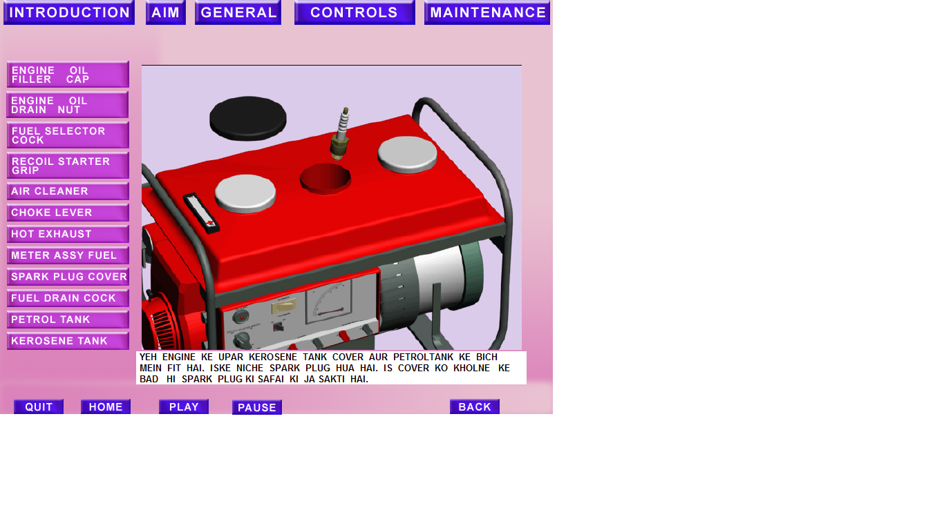
SPARK PLUG COVER

Slide 31
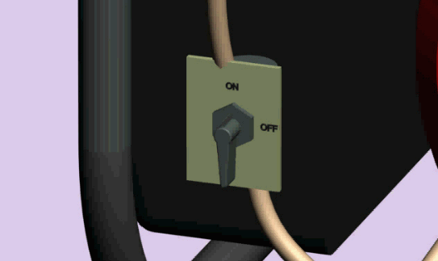
FUEL DRAIN COCK

Slide 32
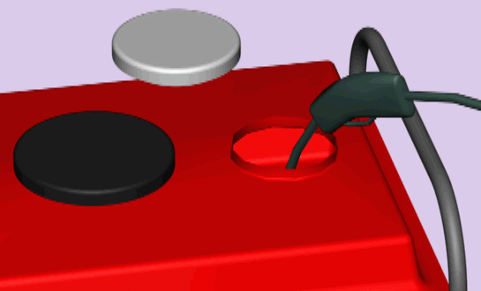
PETROL TANK

Slide 33
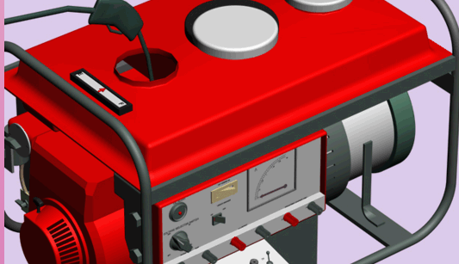
KEROSENE TANK

Slide 34
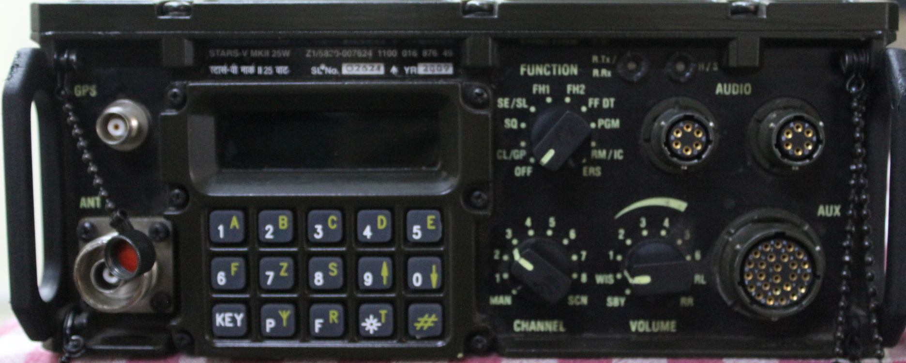
RADIO SET STARS V MK-II
ANY QUESTIONS?

Slide 35

JAI HIND!
JAI HIND!

